Slide 1

Lesson 7 – Particle Filters
Intelligent Mobile Robotics
Dr. Aboozar Taherkhani (PhD)
email: aboozar.taherkhani@dmu.ac.uk

Slide 2
Overview
What is a particle filter?
Bayesian filters
Particle filters
Application to robot localization in 1dimension

Slide 3
What is a Particle Filter?
In the real world we can’t trust single measurements
Knowledge about a measurement needs to be built up recursively over time given a series of measurements
We have already seen this with use of recursive Bayes’ to construct an occupancy grid

Slide 4
What is a Particle Filter?
A particle is a single estimation of a quantity or vector of quantities
A particle filter uses a collection of particles to estimate the value of some quantity
The particles converge from a random initialization to a result given by a probability density function (PDF)
The PDF is discrete – made up of particles

Slide 5
What is a Particle Filter?
A particle filter can be used for robot localization in a map

Slide 6
What is a Particle Filter?
A particle filter is an implementation of a Bayesian filter
We’ll begin by looking at a Bayesian filter
Then see how particle filter realises an implementation of a Bayesian filter

Slide 7
Bayes’ Filters
Bayes Filters address the problem of estimating the state x of a dynamical system from sensor measurements
Estimation given by a (posterior) PDF
Assumes at every time step t we have:
A vector of control measurements u_{t}
Sensory perceptions about the system (ex. Robot Odometry)
A vector of observations Z_{t}
Sensory perceptions about the environment (ex. Sonar reading)
Both contain uncertainties

Slide 8
Bayes’ Filtering
In general we want to estimate some vector x at time t so x_{t}
The estimate is based on:
The current observations
A set of previous observations
A set of previous control measurements
In the Fox paper this estimate is called Bel(x_{t})
For particle filters Bel(x_{t}) is discrete
Values of x with associated weights

Slide 9
Bayes’ Filters
The posterior PDF at time t is denoted Bel(x_{t})
It is conditioned on all previous observations and control measurements
It is updated recursively in two phases:
Prediction
Use control measurements to estimate a new value of Bel(x_{t})
Correction
Use observations to assess new value of Bel(x_{t})

Slide 10
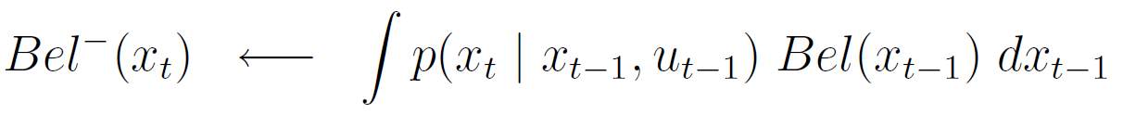
Bayes’ Filters
Prediction
Whenever a new measurement u_{t-1} is taken at time t
NOTE: t-1 not t!
Correction
Whenever an observation z_{t} is taken at time t
Both are performed at time t

Slide 11
Bayes’ Filters
PDFs
Provide estimation of system state
Prediction
Whenever a new measurement u_{t-1} is taken at time t
NOTE: t-1 not t!
Correction
Whenever an observation z_{t} is taken at time t
Both are performed at time t

Slide 12
Bayes’ Filters
Probabilistic model of system dynamics
Given state of system at t-1 and measurement of change in system, what is system like now?
Prediction
Whenever a new measurement u_{t-1} is taken at time t
NOTE: t-1 not t!
Correction
Whenever an observation z_{t} is taken at time t
Both are performed at time t

Slide 13
Bayes’ Filters
Probabilistic model of perceptions
Given state, what is the likelihood of making this observation
Prediction
Whenever a new measurement u_{t-1} is taken at time t
NOTE: t-1 not t!
Correction
Whenever an observation z_{t} is taken at time t
Both are performed at time t

Slide 14
Bayes’ Filters
Normalising factor
Ensure integral of Bel(x_{t}) is 1
Prediction
Whenever a new measurement u_{t-1} is taken at time t
NOTE: t-1 not t!
Correction
Whenever an observation z_{t} is taken at time t
Both are performed at time t

Slide 15
Bayes’ Filters
Implementation
To implement a Bayesian filter we need to implement three things:
The belief probability density function:
The model of system dynamics
The perceptual model
In a particle filter these are all discrete functions

Slide 16



Particle Filtering: Belief function
Belief function is a set S of n ordered pairs
Each ordered pair gives a single point in the belief function consisting of:
A state:
A weight (likelihood of that state):
Overall:

Slide 17
Particle Filtering: Model of system dynamics is probabilistic
Lets assume system dynamics noise fits a normal distribution
This distribution should be centred over the change in the system
Standard deviation should be proportional to change in the system
So:
c = u_{t}
σ = k u_{t}
p(x_{t} | x_{t-1}, u_{t-1}) = x_{t-1} + N(c, σ)
σ
c

Slide 18
Particle Filtering
Perceptual Model is probabilistic:
How to answer the question:
“Given state x, what is the likelihood that I would make observation z?”
We need an prior probabilistic model of the environment built through observation
An occupancy grid will do nicely!

Slide 19
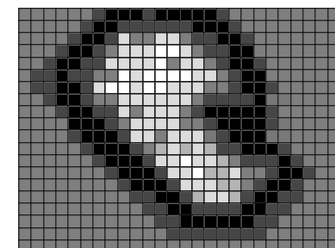
Particle Filtering
Perceptual Model is probabilistic:
State is (x, y, θ) observation is (r, θ_{s})
Likelihood of observation is: 1 – difference between contents of the grid square at (r, θ_{s}) and actual observation

Slide 20
Bayes’ Filters
Implementation
To implement a Bayesian filter we need to implement three things:
The belief probability density function:
The model of system dynamics
The perceptual model
✓
A set of ordered pairs
A sample from a normal
distribution based on the
movement of system
✓
✓
Prior discrete model of
observations
In a particle filter these are all discrete functions

Slide 21
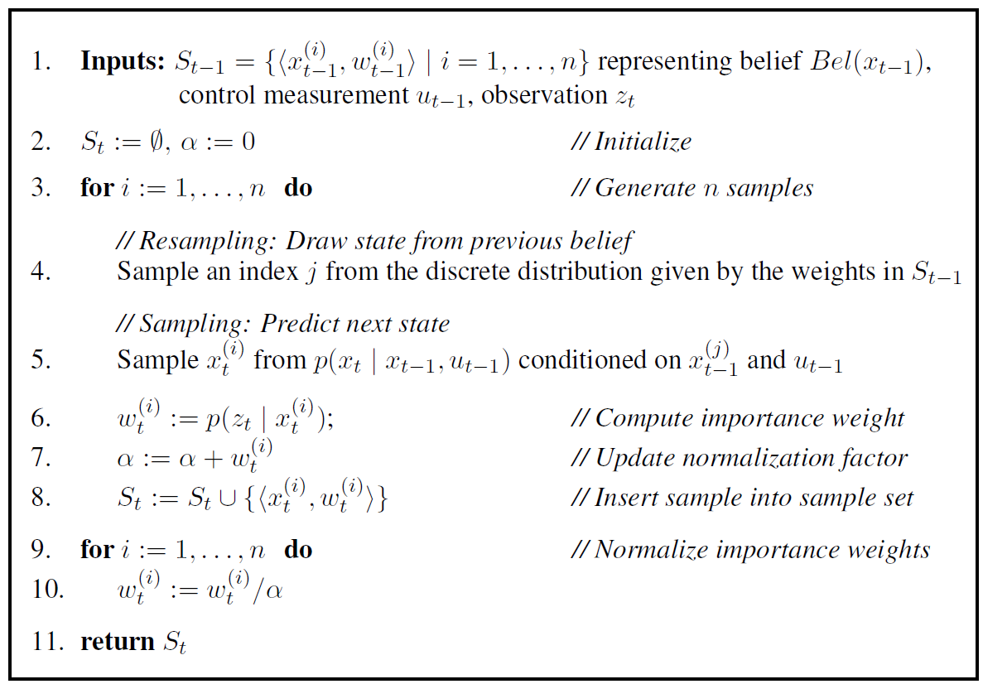
Particle Filter Algorithm (Fox)

Slide 22
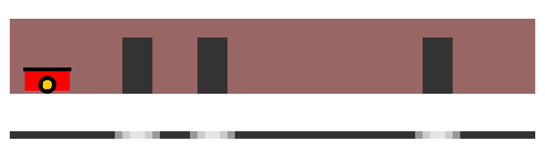
1D Robot Localisation Problem
A robot in a 1 dimensional world
Can only go back or forward
We’ll assume it only goes forward
Lets run the particle filter algorithm!
Wall
Robot
1D occupancy
grid
Gaps in
the wall

Slide 23
Particle Filter Algorithm (Fox)

Slide 24
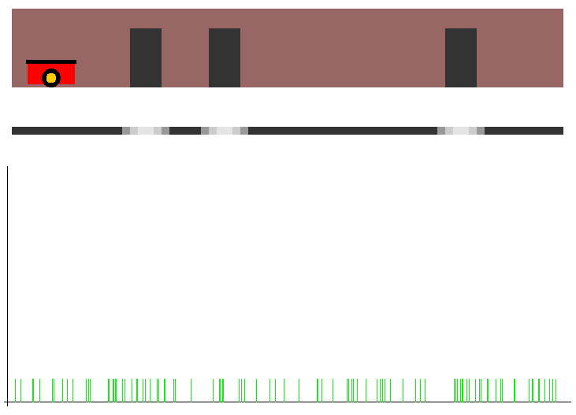
1D Robot Localisation Problem
n = 100
Initialise S_{t-1} with random numbers inside the dimensions of the wall, weighted to 1.0 / n
u_{t-1} = 0
z_{t-1} = 0
S_{t-1}

Slide 25
Particle Filter Algorithm (Fox)

Slide 26
1D Robot Localisation Problem
Select a value j in [1,n]
Selection needs to be weighted by particle weights
Use fitness proportionate selection (GAs)

Slide 27
1D Robot Localisation Problem
We know particle weights sum to one
Pick a random floating point number r in [0,1]
Set sum = 0
Iterate through particles i = 0..n doing
sum += particle weight i
If (sum > r) stop, j = i

Slide 28
Particle Filter Algorithm (Fox)

Slide 29
1D Robot Localisation Problem
Using our selected particle
Set values of c and σ based on u_{t-1}
Sample dx_{t} from N(c, σ)
x_{t} = x_{t-1} + dx_{t}

Slide 30
Particle Filter Algorithm (Fox)

Slide 31
1D Robot Localisation Problem
w_{t} = 1.0 – abs(particle perception – actual perception)
Particle perception
Particle has a position in occupancy girid
Particle’s perception is value in occupancy grid at x
Actual perception
This needs to be simulated based on sensor reading
Add w_{t} to α
Add to the set - does it have to be unique?

Slide 32
Particle Filter Algorithm (Fox)

Slide 33
1D Robot Localisation Problem
Simple normalisation
Divide by α
Ensures integral of S_{t} is 1

Slide 34
1D Robot Localisation Problem
Final step:
Estimate the state
Use mean of maximum
Let the maximum value of w_{t} be M
Let x_{m} be the set of particle states with a weight of M
{x_{i} | w_{i} = M, i=1..n}
Estimated state = Σ x_{i}
#x_{m}

Slide 35
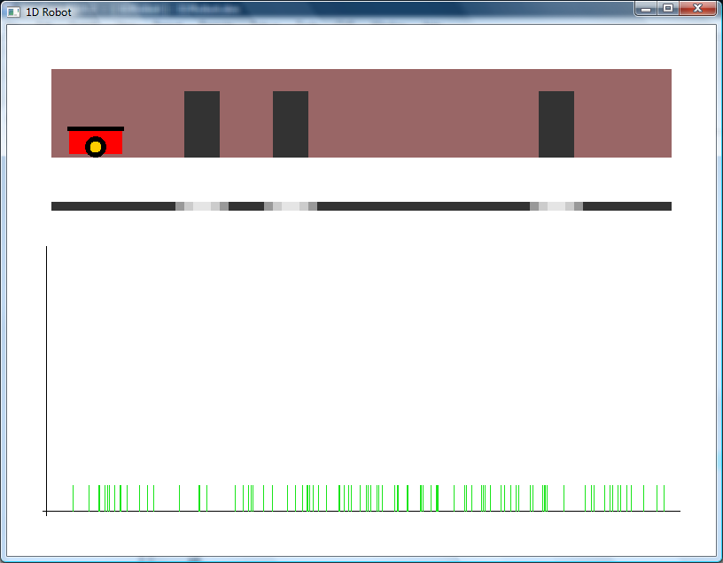
1D Robot Localisation Problem
Particle filter in action t=0

Slide 36
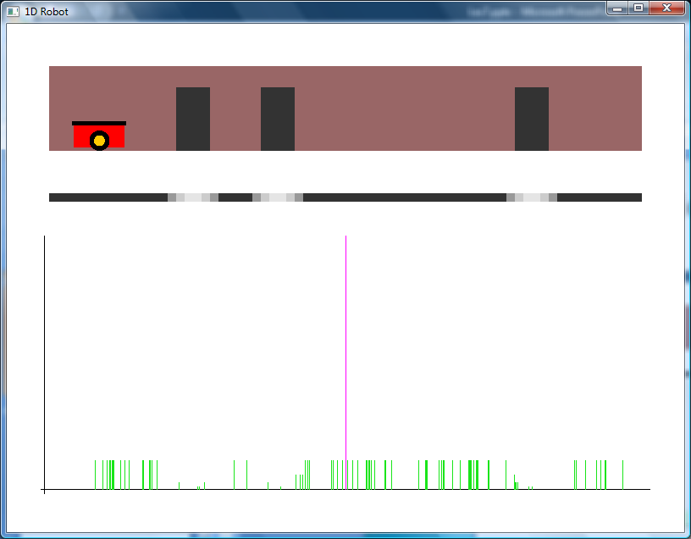
1D Robot Localisation Problem
Particle filter in action t=1

Slide 37
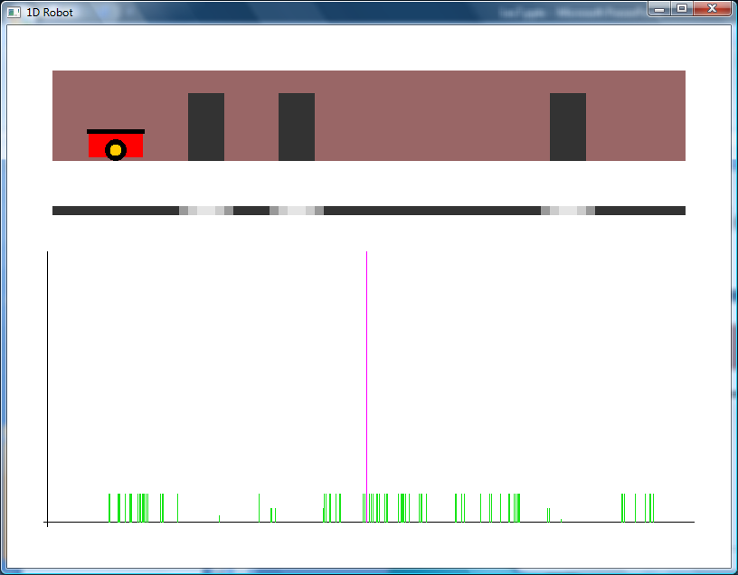
1D Robot Localisation Problem
Particle filter in action t=2

Slide 38
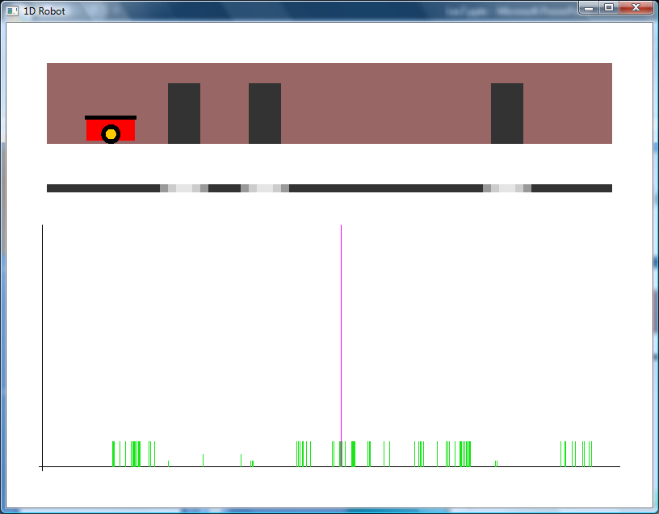
1D Robot Localisation Problem
Particle filter in action t=3

Slide 39
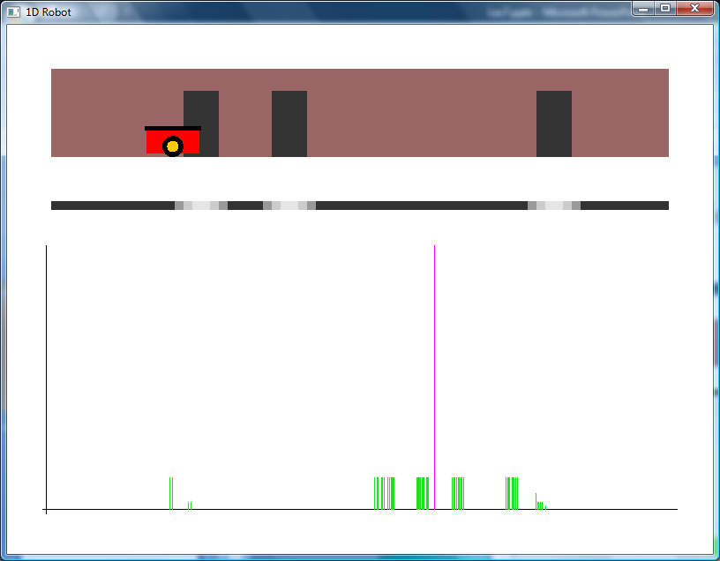
1D Robot Localisation Problem
Particle filter in action t=9

Slide 40
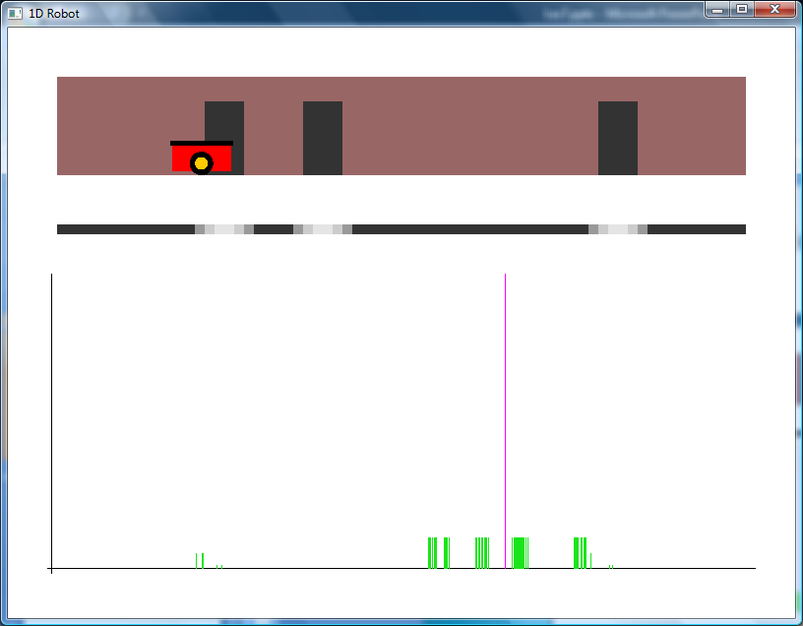
1D Robot Localisation Problem
Particle filter in action t=10

Slide 41
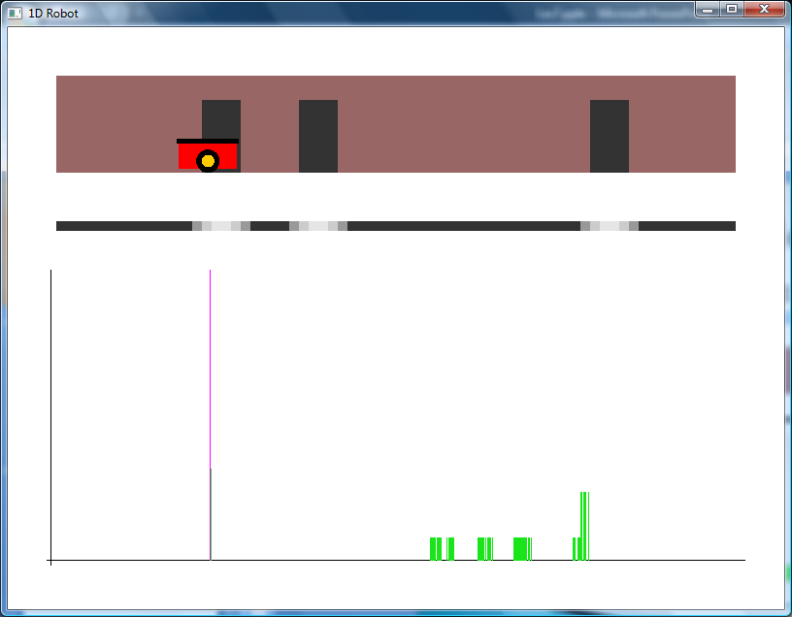
1D Robot Localisation Problem
Particle filter in action t=11

Slide 42
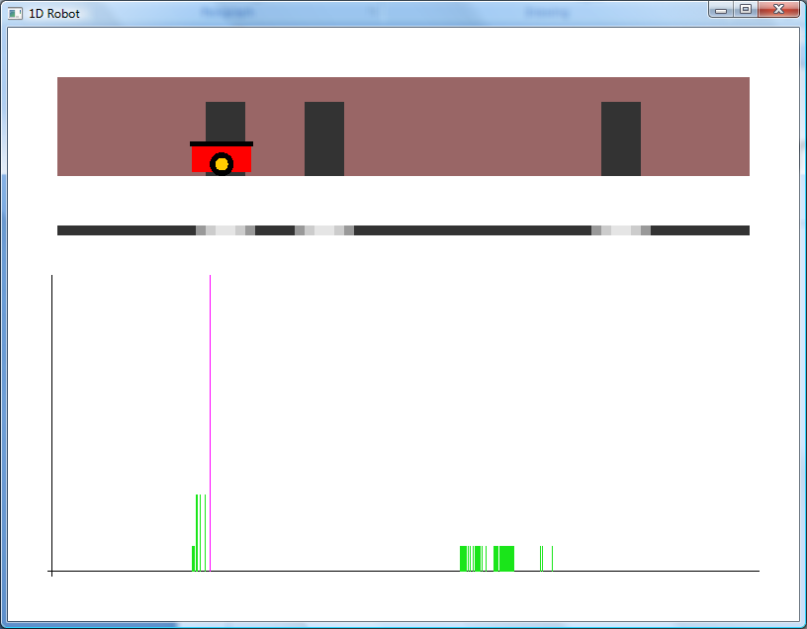
1D Robot Localisation Problem
Particle filter in action t=12

Slide 43
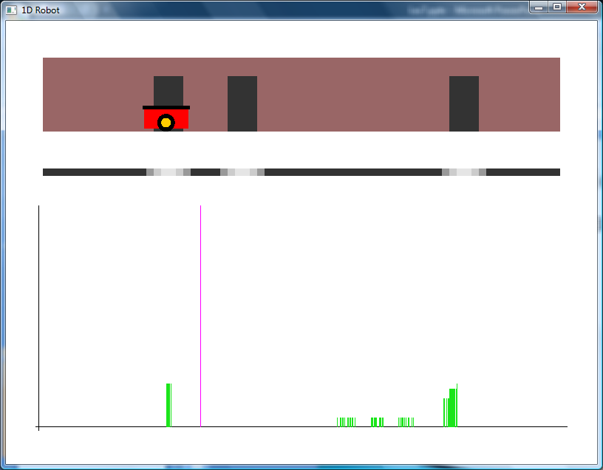
1D Robot Localisation Problem
Particle filter in action t=13

Slide 44
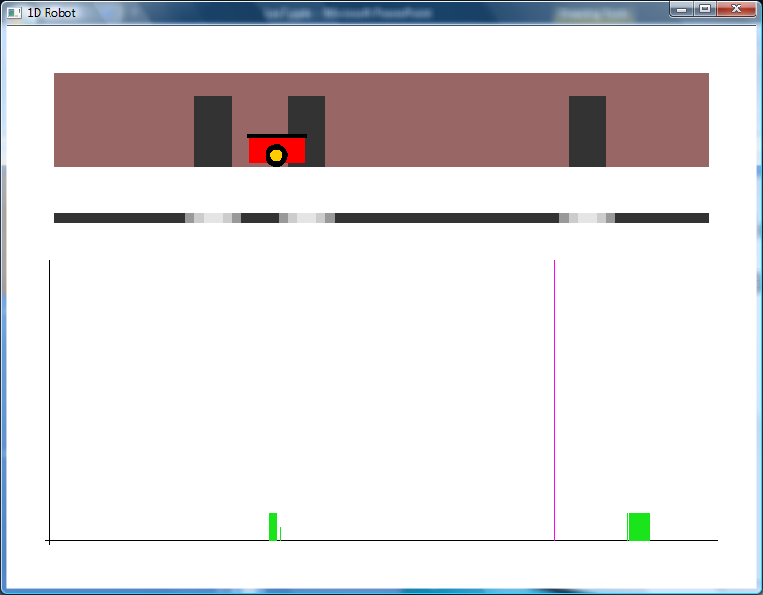
1D Robot Localisation Problem
Particle filter in action t=21

Slide 45
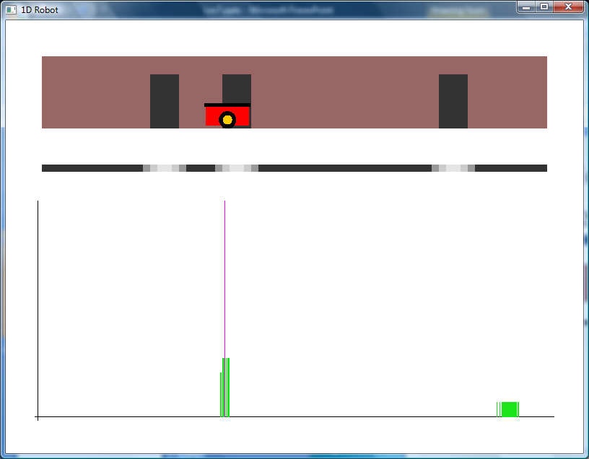
1D Robot Localisation Problem
Particle filter in action t=22

Slide 46
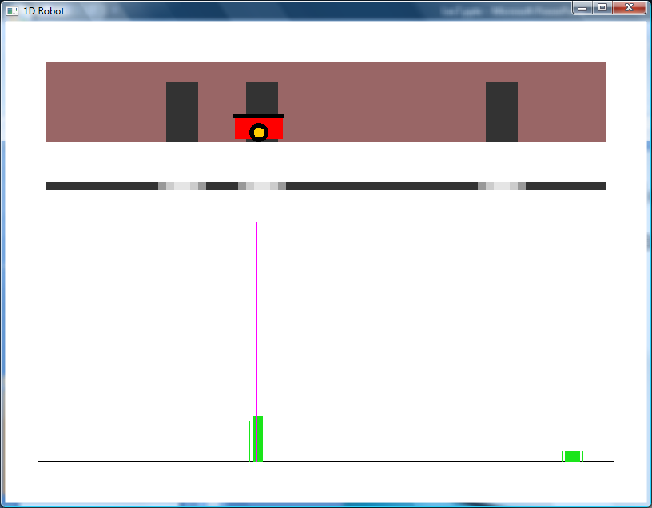
1D Robot Localisation Problem
Particle filter in action t=23

Slide 47
1D Robot Localisation Problem
Real time demo
Don’t expect it to work every time

Slide 48
Summary
Bayes’ filters apply recursive Bayes’ to a chain of motions and observations to estimate a state vector
Particle filters implement Bayes’ filters with sampled probability, so discrete PDFs
Particle filters can be used for localization
Demonstrated how to perform 1D localization

